Slide 1

AuE-8230 Autonomy: Science and Systems
Capstone Project
Group 1: Chinmay Samak, Tanmay Samak
Codebase

Slide 2
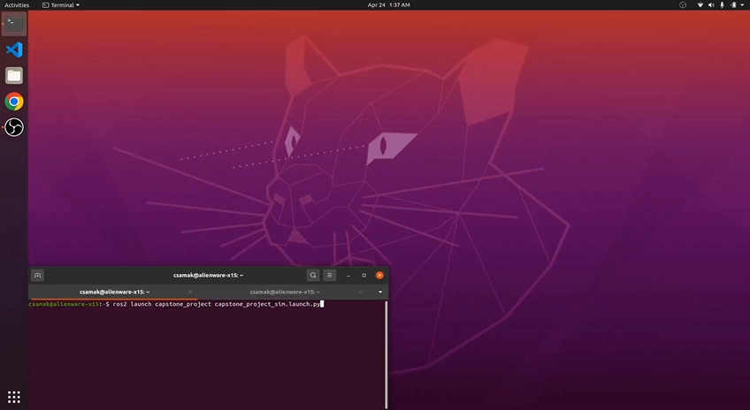
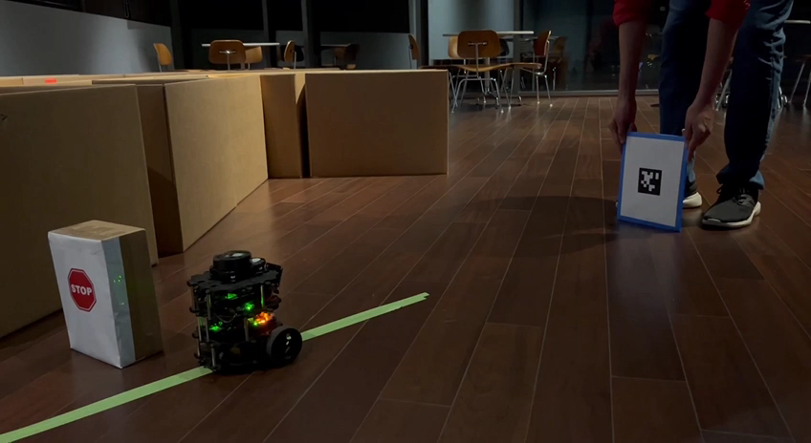
Robustness Testing
Simulation
Forward Direction;
Start with AprilTag Tracking
Reality
Night; Forward Direction;
Start with AprilTag Tracking

Slide 3
Thank you!
…open to questions and suggestions

